Slide 1
IMPACT HIRING #4 – Creating Success from the Start
Patricia A. Frame
Strategies for Human Resources
SHRinsight.com
@2Patra

Slide 2
What Are Your Best Options Now?
Notes:
You have found and assessed applicants, now lets talk about hiring and ensuring the new hire succeeds.

Slide 3
SELECTION
Can the person do the job?
Will the person do the job?
Cultural Fit
Notes:
In assessing the applicants, you reviewed their materials and interviewed each and checked references on your top 1-2 selectees. You and your interviewing team assessed each and discussed any concerns or differing opinions and you are ready to make the offer. Let’s make it an effective one – this is marketing to that person.

Slide 4
MAKE THE OFFER
Notes:
Along the way you have answered their questions and learned what you need – that should include how they fit in your pay range as well as what interests them. Use your knowledge to put together the best offer you can make. Being cheap, ignoring applicants interests, or being sloppy all raise the chances you will fail.

Slide 5
MAKE THE OFFER Best Offer or Negotiation Possible
Notes:
Decide in advance whether you will negotiate or not. Many companies do and many do not. But you need to have your ideas – and if you are negotiating, your parameters ready.

Slide 6
MAKE THE OFFER How Do You Structure the Offer?
Compensation
Title
Start Date
Special Issues
Notes:
Prepare a formal written offer – this protects you both. Have a signature block for the person and state how long they have to respond. In most cases a week or two is smart. The person needs time to assess the offer, talk with family, etc. But you do not want an offer out there ‘hanging’ too long. Include the basics of title, pay and your preferred start date. If you have made any specific side deals with the person be sure to include those – this is a legal record. Protect yourself from misunderstandings.

Slide 7
MAKE THE OFFER Negotiating Basics
What are you willing to negotiate about?
Defining your ‘best and final’
Notes:
Negotiations can be about a wide range of things. Most of us think immediately about direct compensation. But candidates often ask about time off for an already scheduled event, extra vacation time, bigger titles, and all sorts of things. If you are too far apart or you never negotiate, just tell the person so. But if you are willing to negotiate, look carefully at what is being asked for. 1-2 changes are fine to consider but when a candidate has a long list, you may want to just say no. You can counter-offer of course. So if you cannot pay more, you might offer a pay review in 3 to 6 months when you will have a better feel for the person’s value.

Slide 8
MAKE THE OFFER
Put It in Writing!
Notes:
Whether you negotiate or not, the offer and any changes to the offer should be in writing. This saves trouble and potential risk later when the inevitable argument about ‘but I was promised a promotion in six months’ occur.

Slide 9
MAKE THE OFFER Put It in Writing!
Be complete
Set a time frame
Be positive and reflect your culture

Slide 10
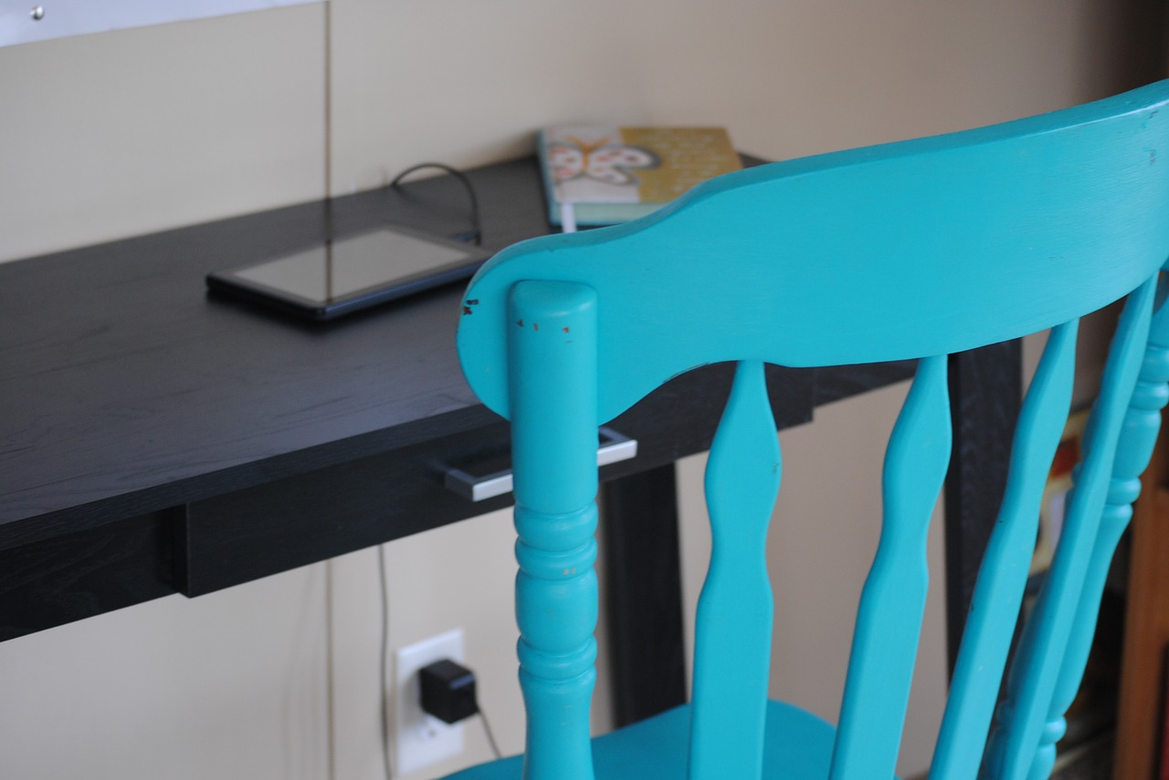
ADVANCE PREPARATION
Notes:
Seems so obvious, but often this gets lost in other work and the new person arrives but nothing is ready. So be sure you have workspace and/or equipment/supplies needed available on the first day.

Slide 11
ADVANCE PREPARATION
First month work plan
Employees told
Buddy option
Notes:
These are items to think about right away in planning for the first day. What are you going to have the person doing that first week, and through the rest of the first month. Is there training required – do they need to know your POS for instance. How and when will you tell current employees? Consider having a person assigned as their ‘buddy’ so that someone besides you is helping with ordinary questions and is invested in the new hire’s success.

Slide 12
ADVANCE PREPARATION
“Keep Them Warm”
Notes:
If for some reason the new person will not start for more than one-two weeks, then keep them in the loop until they do. Send them copies of employee newsletters or customer-focused emails, for example.

Slide 13
SET UP FOR SUCCESS
Notes:
Most attrition in the first 12 months is due to poor hiring and lack of adequate orientation. Pretty costly!

Slide 14
SET UP FOR SUCCESS
Review Why Hired
Notes:
On the first day, do not start out with the administrative stuff. Put it later in the day. Maybe you should start them an hour later than normal so you are ready too.
Remind the person why you hired them – how prepared they were in their company research, their technical skills, their attitude – whatever your reasons were.

Slide 15
SET UP FOR SUCCESS
Review Why Hired
Culture, Values
Notes:
Describe your culture and values. What is important for them to know to really understand how to work well there? What do you want them thinking about so they can be productive?

Slide 16
SET UP FOR SUCCESS
Review Why Hired
Culture, Values
Organization & Work Goals
Notes:
Describe your strategy, the goals for their work unit and how they fit into the organization.

Slide 17
SET UP FOR SUCCESS
Review Why Hired
Culture, Values
Organization & Work Goals
How to Work With You
Notes:
If you supervise the person, this part is about you. If someone else does, it is important that they do this piece and the remaining parts below. Talk about how you like to work, do you want early notice of problems or do you expect the person to try to solve them first? Are you someone they can stop in the hall or do you prefer a scheduled meeting? What are your staff meetings like? These are some examples but you should be as clear as possible.

Slide 18
SET UP FOR SUCCESS
Introductions
Notes:
Introduce them around the organization. IF employees are disbursed to client sites, talk about when they will meet those people too. Use a bit of their background to make a connection with each current employee.

Slide 19
SET UP FOR SUCCESS
Introductions
Lunch
Notes:
Be sure someone is set up to take the person to lunch the first day – it is kind and sets the tone. For other shifts, make similar efforts.

Slide 20
SET UP FOR SUCCESS
Introductions
Lunch
First Month Work Plan
Notes:
Then describe that first month work plan you composed. Explain your performance expectations. Offer whatever support is needed and tell them who to ask what questions of. Tell them what you want them to keep you informed about and how.

Slide 21
QUESTIONS? Patricia A. Frame SHRinsight.com @2Patra
Notes:
Need more HR help? Alexandria SBDC offers a free hour of advice monthly to its clients – register now.

