Slide 1
IMPACT HIRING #2 – Start Right to Hire Smart
Patricia A. Frame
Strategies for Human Resources
SHRinsight.com
@2Patra

Slide 2
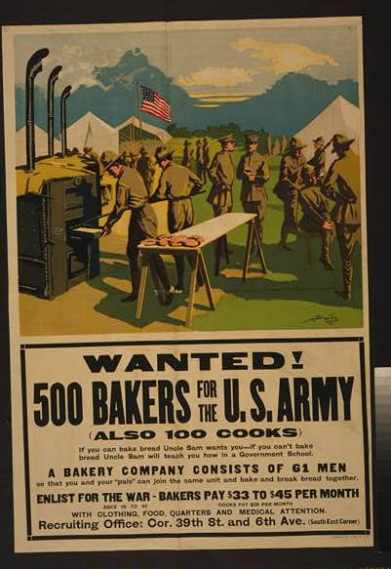
Notes:
Clear, concise, understands audience – are your ads really as good as this WWI one was?

Slide 3
Start Right to Hire Smart
“Proper Preparation Prevents
Piss Poor Performance”
Old USAF Proverb
Notes:
Biggest issue for many small businesses – rush to ‘fix’ , don’t assess current needs, do it same way always done

Slide 4
Planning to Hire

Slide 5
Planning to Hire
Why Are You Hiring?
Notes:
Is it a real long-term need which you can fund? The best 3 reasons are…

Slide 6
Why Hire?
Turning down New Projects or New Clients
Adding new business line or revenue stream
Improving Customer Service or Retention
Notes:
Notice that each of these offer a way to increase revenues or profitability! Sure you want someone to do all those jobs you dislike doing, but is that realistic for your stage?

Slide 7
Planning to Hire
What is Required to
Succeed in the Job?
Notes:
Take a look at an open position or one you have increasing needs for and let’s get specific about what you must have. First look at the minimum requirements needed to succeed in the job.

Slide 8
Planning to Hire
Requirements to Succeed
Specific skills
Notes:
What skills? List those which you must have, not ‘nice to have’ What level of each skill?

Slide 9
Planning to Hire
Requirements to Succeed
Specific skills
Education or training
Notes:
Here you must consider what types of training and education are critical. Note that under EEO guidance, just saying a Bachelors degree is not allowed, it must be relevant to the work and required to do the work. A BS, Mathematics for a data analysis job would be fine, for example.

Slide 10
Planning to Hire
Requirements to Succeed
Specific skills
Education or training
Attitude
Notes:
What is required to succeed in your organization? Customer service? Desire to keep learning – important for high-change fields. Ability to deal with wide range of people –common for retail.

Slide 11
Planning to Hire
Requirements to Succeed
Specific skills
Education or training
Attitude
Preferences
Notes:
All the above were the minimum requirements needed to do the job. You may have added preferences based on other aspects of your organization – perhaps social media exposure, public speaking ability. These preferences are considered only once you have candidates who meet all the minimum requirements.

Slide 12
Planning to Hire
What Do You Offer?
Courtesy of Thomas Quine via Creative Commons
Notes:
Few small businesses can compete with the famous ones for perks – this is the 18th century foosball and gaming table. But all of us offer some unique aspects and desirable options to attract applicants.

Slide 13
Planning to Hire
What Do You Offer?
Unique Aspects of Your Organization
Notes:
Think about yours – might it be your culture? Flexible work hours? Training or development options? Location?

Slide 14
Planning to Hire
What Do You Offer?
Unique Aspects of Your Organization
Culture
Notes:
Culture is ‘how one succeeds here’ and ‘the way we work’ – what makes yours interesting?

Slide 15
Planning to Hire
What Do You Offer?
Unique Aspects of Your Organization
Culture
Other
Notes:
Anything else that will help you attract the right person.

Slide 16
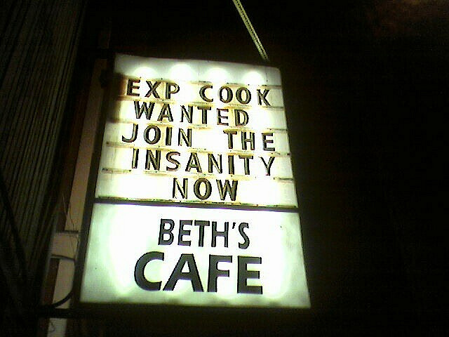
Planning to Hire
Writing An Ad
Courtesy of Nonsequiturlass
Notes:
Now here is one that tells all a critical bit about the work environment!

Slide 17
Planning to Hire
Writing An Ad
Challenges
Notes:
When you are writing an ad for a position, you want to attract the right people and repel the wrong ones. Challenges the person will face in the job is a great way to set expectations while discouraging those who are not so interested in challenges. A challenge might be maintaining legacy computer systems and those with new technology.

Slide 18
Planning to Hire
Writing An Ad
Challenges
Requirements
Notes:
Don’t drag your ad down with a long list of requirements. It is an ad, not a government job description. Concentrate on a few critical requirements and omit lower importance ones.

Slide 19
Planning to Hire
Writing An Ad
Challenges
Requirements
Story
Notes:
Your story is a vital piece in attracting the right applicants. Tell the story of your organization in a paragraph of rich words that demonstrate what is important to you.

Slide 20
Planning to Hire
Writing An Ad
Challenges
Requirements
Story
How Apply
Notes:
How do you want to get applications? Do you want to use a cover letter to weed out some people who do not bother to learn about you or lack attention to detail? Are people able to apply by email? Mobile apps? In person? Give them the details!

Slide 21
Planning to Hire
Sourcing
Notes:
Sourcing is how you actually find applicants. In big firms this is a specialized position. In smaller ones it often starts as ‘family and friends’ – which can be effective if done well and all the same requirements are applied.

Slide 22
Planning to Hire
Sourcing
Better: Network Email
Notes:
Better yet is to open up that ad you wrote and turn it into a 3-4 paragraph email and send it out to your network. Don’t forget vendors and weak connections.

Slide 23
Planning to Hire
Sourcing
Often Best: Employee Referrals
Notes:
Better yet is to add in employee referrals. Employees understand your culture and most will not want to work with someone who is not competent plus they realize that their ‘good name’ is at risk. So tell your employees what you need and how to refer people. If you can afford it a token of appreciation, given to everyone who makes a referral, is nice gesture – a mug or similar small present is fine.

Slide 24
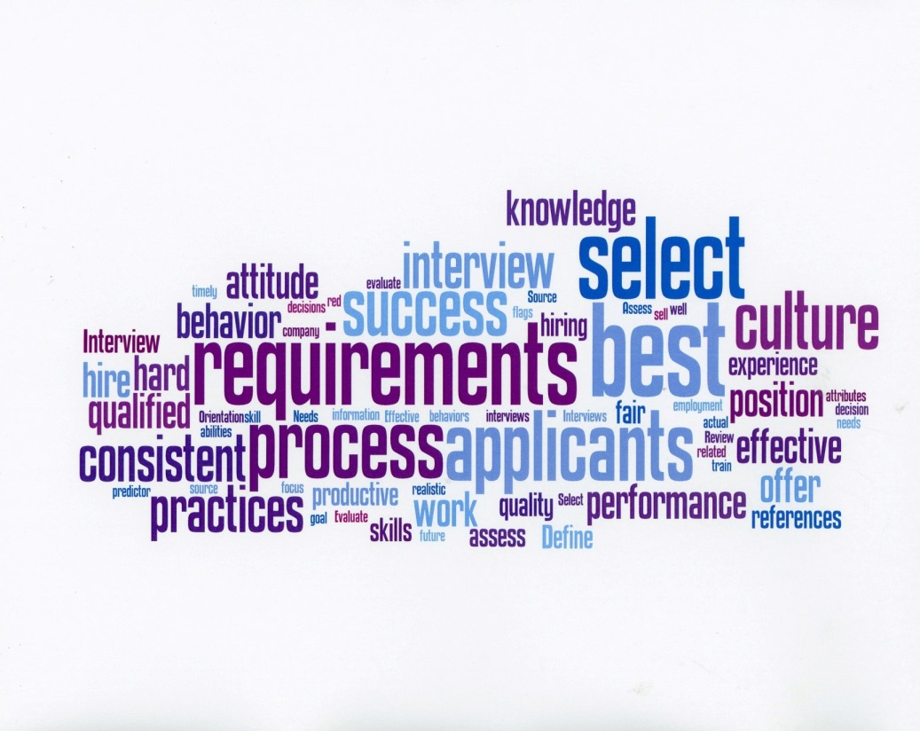
Planning to Hire
Defining the Process
Notes:
Sounds like a lot of work doesn’t it? But doing the planning can save you a burden of retraining, counseling, rework or terminations.

Slide 25
IMPACT HIRING CONTINUES
July 8: Interviews & Selection
July 15: Offers to Orientation

Slide 26
QUESTIONS? Patricia A. Frame SHRinsight.com @2Patra

