Slide 1
Boot Camp for Changing the World
How to Start Manage and Grow a Nonprofit Organization
Alexandria, Small Business Development Center

Slide 2
Who We Are
Jennifer Ayers, MPA,Consultant, JL Ayers Consulting, LLC
Larry Checco, Checco Communications, Branding Expert
Tom Hay, Ph.D., A2B Research and Development, LLC
Page Moon, Focus Data Solutions
Cathy Pennington, CPA, Shareholder Renner & Company
Benjamin Takis, Attorney, Tax-Exempt Solutions, PLLC
Robert Weil, Law Office of Robert J. Weil, PLLC, Non-profit legal counsel

Slide 3

NPO Basics
Planning for Growth
Governance
  Running a board meeting
  Do’s and Don’t of Being on a Board of Directors
Policies & Risk
Legal Parameters for Good Governance
Why having good policies are important to reducing risk
Who’s liable?
Development Strategy
  Different types of fundraising
  Where to find resources – build relationships
  Building Metrics & Outcomes
Planning Basics

Slide 4

Ready to meet Targets?
Bylaws
Policies and Procedures
Board of Directors
Resources
Strategic Plan
Implementation

Slide 5
Field Test- Governance
Elect Officers
Order of business
  How will decisions be made
Key Committees
  Audit/Finance
  Nominations
  Executive
Notes:
Just a word on Board Development
I could spend a lot of time here- but it’s important enough, that I wanted to make sure we touched on this here.
Once you are incorporated you will need a board of directors to set the policy and strategy for the organization.
Think about the skills you need on the board now and how that may change- you may want to do inventory.
Start small- you don’t need a huge board at first- allow for the board to grow and change as the organization changes
Think about personalities and finding people who bring different strengths.
Strengths Finder. Team Building- Orientation.
Start with good practices at the begging. Rotate terms, set term limits, provide orientation and send board leadership to training.

Slide 6
Roles & Responsibilities
Board
Staff/Executive
Manage the organization/Admin.
Hire & Fire, supervised & motivate staff
Fiduciary on the Board without vote (usually)
Implement a strategic plan
Provide leadership
Represent the organization to the public
Raise money
Build new programs
Write reports
Prepare information for the board
Report to the board of directors
Fiduciary of the organization
Provide direction to CEO/ED
Sets policies
Develop a Strategic Plan
Review strategic goals
Provide visionary leadership
Set direction for the organization
Represent the organization to the public

Slide 7
Perspective On Governance
Robert Weil, Law Office of Robert J. Weil, PLLC, Non-profit legal counsel

Slide 8
Legal Characteristics of a Nonprofit Corporation
The three primary characteristics of nonprofit corporations:
Incorporated or chartered under the laws of a state government and pursuant to nonprofit or non-stock corporate statutes
Tax-exempt status granted by the IRS rendering the organization exempt from paying federal income taxes on any net of revenues over expenditures each year
Governance by volunteers – the principal decision-making mechanism for any association is its governing board most often consisting of volunteers drawn from the field represented by the association

Slide 9
Role of THE nonprofit Board
Determine, review and approve the mission statement and nonprofit purpose
Approve and oversee the strategic plan, policies and operational matters
Selection, evaluation and determination of CEO or Executive Director performance and compensation
Monitor and strengthen organization programs and services

Slide 10
Role of THE nonprofit Board
Hold management accountable for performance
Ensure that the organization has adequate resources to carry out its mission and manage those resources effectively
Oversee financial reporting and auditing processes, internal controls and legal compliance
Oversee financial stability of the organization
Insure inclusiveness and diversity
Insure legal, financial and ethical integrity

Slide 11
Role of THE nonprofit Board
Enhance the organization's reputation and public standing in the community
Help recruit and maintain a competent board
Be active and be more than a figurehead
Regularly re-evaluate the role as a director

Slide 12
Powers of Board of Directors
Managerial and not legal in nature
The legal entity, not the board, holds the legal power of the organization
State nonprofit corporation statutes typically define obligations and duties of a director, as does the common law
Critical to become familiar with the organization’s state nonprofit statute

Slide 13
Continuing duties of a Director
At all times act reasonably and in good faith
At all times exercise the level of care that an ordinarily prudent person would exercise if placed in a like position and under similar circumstances
Avoid negligence, fraud, conflicts of interest
At all times act in a manner the director reasonably believes to be in the best interests of the organization
Avoid generating legal liability for association

Slide 14
Standards of Performance
Duty of Care – “…care that an ordinarily prudent person would exercise in a like position and under similar circumstances.” In other words, avoid negligence or fraud.
Duty of Loyalty – Give undivided allegiance when making decisions impacting the organization. Loyalty requires the exercise of independence of judgment and action. Avoid conflicts.
Duty of Obedience – Act in a manner faithful to and consistent with the organization’s mission/nonprofit purpose.

Slide 15
Avoiding Personal Liability
Volunteer directors must act prudently and not recklessly in organization matters
There is little risk of exposure if the director exercises ordinary diligence and care
Good faith is the principal test of ordinary diligence and due care
Even incompetence and bad judgment may not be enough to impose personal liability, though bad faith or fraud will
Directors are entitled to rely on advice and opinions of credentialed experts

Slide 16
Personal Liability Risks
Do not exceed corporate power and authority as a director and governing body, i.e.(ultra vires)
Intentional misconduct causing injury to person or property
Typical complaints directed against officers and directors in the course of their activities: negligence, defamation and interference with contractual rights of third parties
Knowing participation in criminal activity, i.e. antitrust violation, fraud, etc.

Slide 17
Attributes of a good Director
Ability and willingness to listen, assess, think critically, creatively and ask questions
Ability to work with others in a group setting
Ability to help build consensus
Willingness to prepare for and attend board and committee meetings, i.e. do the required homework in advance of and after meetings

Slide 18
Attributes of a good Director
Willingness to do the work (follow through on assignments between meetings, contribute personal and/or financial resources)
Willingness to help cultivate funding sources and recruit new board members

Slide 19
Attributes of a good Director
Be a good student (review and become familiar with the legally operative documents and finances of the organization, including articles, bylaws, 990 returns, year end reports, Board governance policies, etc.) and be familiar with and understand the organization’s programs
Be honest, responsive and tolerant of opposing views
Be ready, willing and able to at all times put the organization’s interests before your own

Slide 20
Conflicts of Interest and Self Dealing
Each director has a continuing duty of complete loyalty to the organization he or she serves
Avoid actual as well as perceived conflict situations and self-dealing whenever possible
Where unavoidable: 1) Is the activity clearly beneficial to the organization? 2) Is it fair and reasonable to the organization? 3) Has it been fully disclosed? 4) Is there any unjustified advantage or gain to the director?

Slide 21
Conflicts of Interest and Self Dealing
As a board, demand full disclosure and full documentation of any potential conflict
Transaction may be allowed though also be voidable at the option of the board
When in doubt, FULLY DISCLOSE!

Slide 22
Director Liability safeguards
Measures to reduce liability as a director:
Become educated about how the organization runs and its mission before assuming the director position. What expectations are placed on directors?
Become familiar with legally operative documents, i.e. bylaws, articles, etc.
Attend board meetings, but if one is missed, read the minutes and ask questions before they are approved
While at meetings, participate and make sure what is on the table is understood
Avoid even the appearance of a conflict or self-dealing situation

Slide 23
Director Liability safeguards
Abstain from voting and/or participating in discussions on issues that present a real or potential conflict
When disagreeing with the majority on an issue that is significant, ask that the minutes reflect the opposition position on the record
Whenever a matter arises that requires a legal opinion, request that legal advice be obtained before final board action is taken
Make sure all major policy, financial, and business transactions of the organization are understood before casting a vote

Slide 24
Director Liability safeguards
Understand the duties and powers of one holding a directorship, i.e. what are the fiduciary and statutory duties to the organization?
Does the organization have clearly defined conflict of interest/disclosure, antitrust, whistleblower, document retention and gift acceptance policies? How often are they reviewed? Are they followed?
Is there a written investment policy?
Is there an annual outside audit?
Do the bylaws provide for indemnification of directors?

Slide 25
Director Liability safeguards
Is there a board audit or finance committee?
Has there been a legal compliance audit?
Are agendas and minutes reviewed by counsel?
Are agendas prepared and circulated in advance?
Are agenda’s followed?
Are corporate formalities maintained?
Are minutes reviewed and approved?
Are there attendance requirements?
Are disciplinary matters involving board members or association members the subject of due process?

Slide 26
NONPROFIT Insurance
Does the organization have current Directors and Officers Liability (D&O) insurance or Association Professional Liability insurance?
Who and what does the insurance cover?
Covers organization, officers, directors, employees, volunteers and related organizations, like a foundation
Does it pay defense costs?
What claims are covered? Does not cover property damage or bodily injury
Is there discretion in selection of defense counsel?
What other insurance coverage is necessary?

Slide 27
Areas of Director Concern
Antitrust compliance: Of particular concern to trade associations or professional organizations operating certification or accreditation programs
Is there an antitrust compliance policy and procedure? Sensitive issues – membership restrictions, statistical reporting, credit reporting, standard setting, codes of ethics, conduct of members at association gatherings
Is there a written antitrust policy regularly reviewed with board members and handed out in writing before each meeting?

Slide 28
Areas of Director Concern
Awareness of criminal penalties (jail and fines)
Delegation of Power: Directors should take affirmative steps to ensure that the organization’s activities are conducted in compliance with applicable state and federal statutes, and to establish proper supervision of committees and chapters to reduce risk of liability created by unauthorized acts of members and their employees

Slide 29
Areas of Director Concern
Maintenance of Tax-Exemption
Directors should at all times diligently monitor the organization’s activities and finances to ensure that they are consistent with its tax-exempt purposes and avoid activities that may jeopardize that status

Slide 30
Areas of Director Concern
Poor business decisions: “waste of corporate assets”
Potential liability of directors for corporate waste where caused by director gross negligence and inattention to the duties of office
Defamation: Claims for libel (written defamation) or slander (spoken defamation) can arise in the context of membership disputes, board disputes, defamation of employees, and even suppliers

Slide 31
Areas of Director Concern
Confine board discussions to the board room and not membership and make sure statements made in board meetings are not false or malicious and be cautious with e-mails
Respect corporate opportunities

Slide 32
Good Board Governance
Understand the organization’s nonprofit mission and tax-exempt purposes
Become educated, stay informed and actively participate
Always act in the a manner consistent with the best interests of the organization
When in doubt, disclose even the appearance of a conflict or self dealing
Remember the essential duties – care, loyalty and obedience

Slide 33
Robert J. Weil, Esq.
Law Office of Robert J. Weil PLLC
4031 University Drive
Suite 100
Fairfax, VA 22030
703-934-2036 (office)
703-399-5671 (cell)
bob@rweillaw.com
Copyright Law Office of Robert J. Weil PLLC 2014

Slide 34
Fundamentals of Development
Tom Hay, Ph.D., A2B Research and Development, LLC

Slide 35

Fund Development for Nonprofits
Who might provide financial support?
Why would they want to support your nonprofit?
How do you engage funders?
What do you need before you apply?
What are key components of your appeal or proposal?
What strings are attached?

Slide 36
Setting the Stage
Strategic Plan:
Vision, mission, goals, objectives, activities
  Clear statements of a better condition and how you plan to make it happen
Why your plan will work
  Research literature on the need and how it can be met successfully
Logic model
  Flowchart that shows the resources, activities, outputs and outcomes
Evaluation plan
  Formative and summative evaluations
Open Discussion Lessons Learned

Slide 37
Your Logic Model
There is no single “right way”, but it should contain:
Your planned work (resources, stakeholders, assumptions, activities) on the left, and
Your intended results (outputs, outcomes, impact) on the right.
For a good discussion see: http://learningforsustainability.net/sparksforchange/an-introduction-to-developing-logic-models-eight-key-elements-to-include/
and: http://www.wkkf.org/resource-directory/resource/2006/02/wk-kellogg-foundation-logic-model-development-guide
Where you can download their “Logic Model Development Guide”

Slide 38
Potential Sources of Funding
Federal Government grants, cooperative agreements
State and local government contracts
Foundations
Friends and family
Events
Crowdfunding/Crowdsourcing
Product marketing

Slide 39
Foundations
Range from small, family foundations with a narrow scope to large foundations with international scope.
You can research them through The Foundation Center (www.foundationcenter.org) including their Washington, DC office and at the Fairfax County Government Center.
While there are over 120,000 grantmakers, many do not accept unsolicited proposals.
Keyword search and filters to find those who are interested in your issues and accept proposals or letters of interest.
Unrestricted operating funds are the hardest to get. Program funds may cover some “general and administrative” costs or a percent for overhead and operations.

Slide 40

Key pointers for all Proposals
Follow the directions and be meticulous
Learn about your target (what they have funded, what they promote as success stories)
Be prepared for rejections, and try to get feedback
Inquire about any help available
Corporate-related foundations like employee engagement (volunteers, sponsors)
Local sources are easier for establishing relationships

Slide 41
Other sources
Crowdfunding
  Relatively new concept has been very successful in some cases
  May involve product marketing
  See some examples at: http://mashable.com/2011/10/20/crowdfunding-platforms-social-good/
Events
  Can be small or large, but you need a plan to either make more than you spend or engage donors for later.

Slide 42
Discussion Questions
  What strings are attached to different funds?
    Accounting and accountability
    Program metrics and evaluation
    Reports
    Regulatory requirements (confidentiality of personal information, employment, research involving human subjects, etc)
  How do you plan to grow your nonprofit?
  How much of your own time and money are you ready to invest?
  What is the role of volunteers in your development plan?

Slide 43

Contact
Tom Hay, Ph.D.
A2B Research and Development, LLC
Website: www.a2brd.com
E-mail: tomhay@verizon.net
Office: 703-672-6033

Slide 44
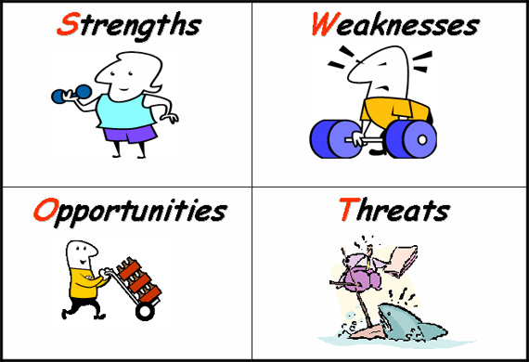
Planning Basics
Jennifer L. Ayers, MPA,
JL Ayers Consulting, LLC
Solutions for Management

Slide 45

Planning
a scheme or method of acting, doing, proceeding, making, etc., developed in advance:
battle plans.
Notes:
But before we begin- let’s do our homework:
I thought about the Blue Oceans management concept recently. Are any of you familiar? Basically- it says that organizations should fish in waters – that have not been previous fished.
So what does this mean- it means finding a unique space and taking an innovate approach
There are a lot of nonprofits- there is competition for resources and there is duplication of effort-
Do your homework- this will help you with your articles, provide focus to programs, and can help the organization build and scale services appropriately
Who will benefit from this organization’s efforts> who will you serve-
What unmet need will it fill? That is what will it do that no other group does already?
Can I give up the reins of control and let others guide me?- You will need a board of directors and you will be accountable to the public as an NPO- so if you are not part of an organization already- you need to think about your role as founder and how the organization will look when you aren’t there, and/or if you are on staff- what you can/should expect from you board.
Are there organizations that do the same or similar thing- probably- how will you distinguish. Environmental Scan- talk to them- see what areas they do not cover or where they leave off- is it still interesting- would you rather support that organization and/or partner with them?

Slide 46
Strategy and Planning
Outcome measures and benchmarks can be used motivate and inspire
Keeps an organization focused on end goal
Provides a shared vision and goal
Carries over from year to year
Creates buy-in
Provides opportunity to establish a position
Accountability- demonstrates who is responsible for execution
Provides a reason for actions
Allows for delegation & empowerment

Slide 47
Components of a Plan
Background and History
Assessment or Evaluation or Environmental Scan
Vision
Mission
Values
Stakeholders
Goals and Objectives
Strategic Implementation Plan or Work Plan

Slide 48
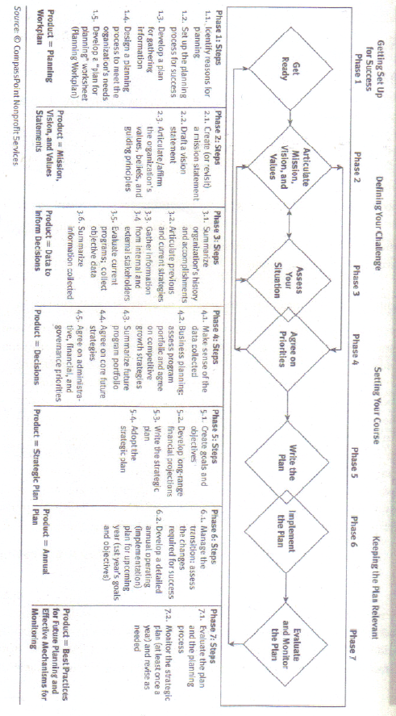
Overview of Planning Process

Slide 49

Example
If the vision is:
  Everyone in the city who wants an eye exam can have one.
Then the mission is:
  Provide eye exams to anyone who needs them.
A goal may be:
  To double the number of people having eye exams annually.
One objective may be:
  Increase volunteers to manage exam sites .
To do this the projects may be:
  Advertise for qualified volunteers in local newspapers and online forums.
  Build relationships with community organizations (name them).
  Hire a coordinator to build relationships in year one.

Slide 50
Free Eye Exams
Program | Goals | Objectives | Measures | Program Projects
Free Eye Exam Clinics | Increase the number of people receiving free eye exams | Make it a valuable experience for participants Increase the number of volunteers providing exams Raise money to cover expenses associated with manager and coordinator, equipment and advertising Ensure people in need of eye exam know about the program | Follow-up surveys to organizations using our volunteers Increase volunteers by 5% $100,000 is needed to operate to cover costs Measure the number of organizations who agree to post notices | Supervise exams, administer follow-up survey, and share results Advertise need for volunteers in regular communications Work with development committee on a capital campaign to start in first quarter. Increase outreach to specific organizations, such as public health department, schools, recreation centers

Slide 51

Quick Tests/Assessment
S.W.O.T.
  Strengths
  Weaknesses
  Opportunities
  Threats
P.E.S.T.
  Political
  Economic
  Social
  Technological
Policy 101
  Who supports?
  Who opposes?
  What is the cost?
  Is it feasible?
Logic Model
  Input
    Program Background
    Activities
    External Factors
  Output
    Outcomes
    Goals

Slide 52
S.M.A.R.T.
Specific
Measurable
Attainable
Realistic
Timely

Slide 53
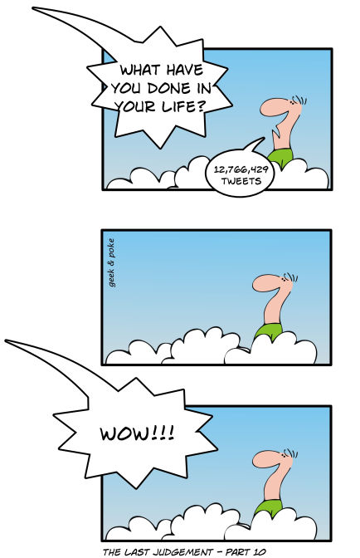
Exit Strategy
How did the organization get to where it is now?
What legacy or impact should it leave?
What will happen when we are no longer here?

Slide 54
Upcoming Workshop
Operating Well
Larry Checco, Page Moon, Ben Takis, Cathy Pennington & Jennifer Ayers
Charity Rankings- Best Practices
Financial Operations
  Financial considerations for managing grants
  reporting Financial Data
  Auditing/Controls
Policy & Risk
  What to know about employees
Marketing Strategy
  Messaging and branding
  Getting People to Notice
Developing an IT policy & determining your needs
March 27

Slide 55
Contact Information
Robert Weil, Law Office of Robert J. Weil, PLLC, Non-profit legal counsel
Bob@rweillaw.com
Tom Hay, Ph.D., A2B Research and
Development, LLC
tomhay@verizon.net
Jennifer Ayers, MPA
JL Ayers Consulting, LLC
jayers@jlayersconsulting.com

